Slide 1
Improving Hospital Patients’ Well-Being Through Technology
By: Josh Perrine

Slide 2
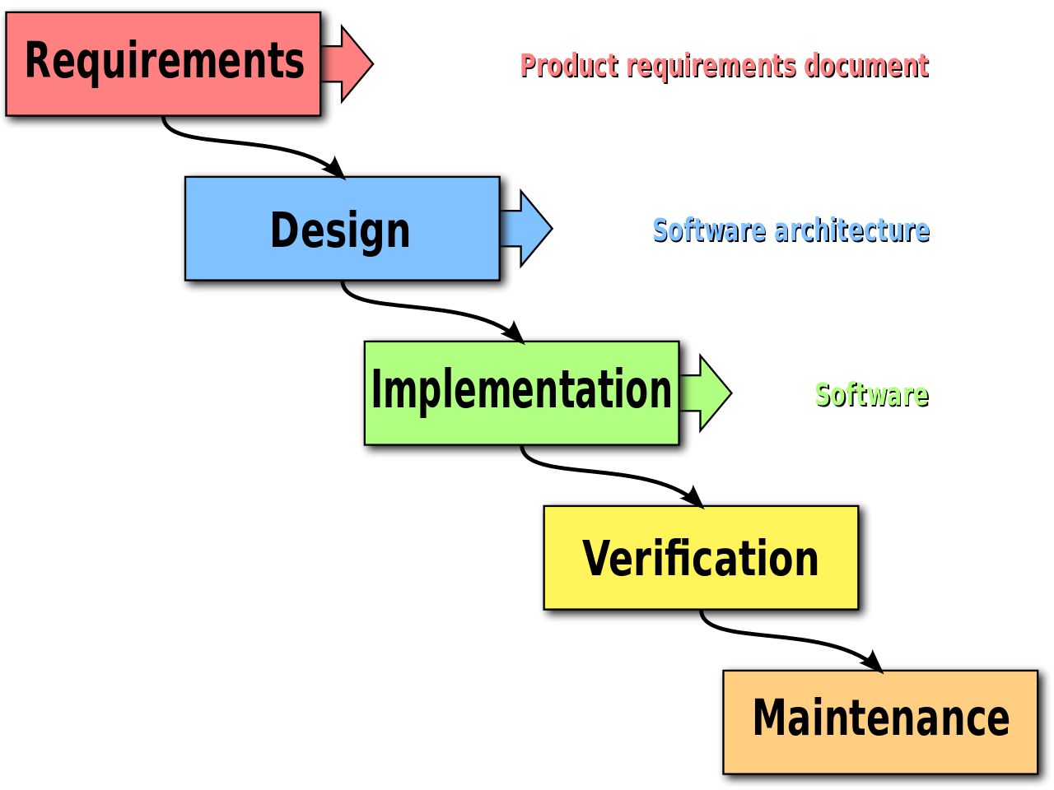
Project Introduction
I’m in the beginning of developing an application to help hospital patients’ overall well-being.
Focusing on the requirements gathering and design stages in the software development cycle.
Application has various aspects including:
Access to connections and support groups
Relaxation Exercises
Mindful Activities
Holistic Care
This idea was introduced to me by my roommate, Henry.
Notes:
Introduce yourself for a moment.
Talk about the app that’s been in development… Users would be able to access this either as a mobile app or website accessible from a smart phone or pc.
Talk about reading and learning about requirements gathering and design stages… read textbooks, reached out to others, etc.
-Mention the software development process stages and outline where you are in the process/ what you’ve done.
Transition to next slide... This is a great idea from Henry, but the requirements for this application needed to be gathered.

Slide 3

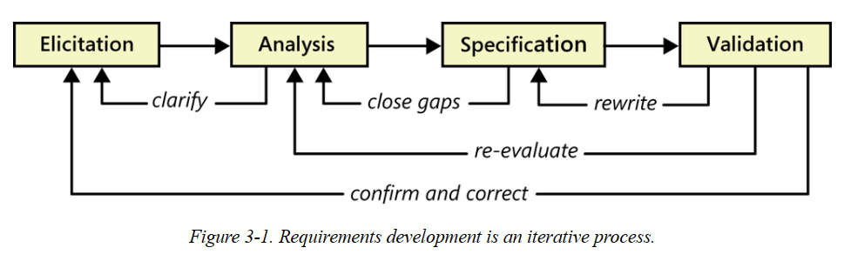
Requirements Gathering
To start the application, I had to go through the requirements gathering process.
Read about requirements gathering.
Software Requirements, 3rd Edition
Outlined the basics of requirements gathering, what should be expected, how to do it
This is the framework for requirements engineering:
Notes:
Talk about the textbook and the framework for requirements engineering…
Elicitation – Some tasks that would happen here would be defining the product vision and project scope, identifying user classes and characteristics, working with user representatives to identify user requirements, and getting information and input from users.
Analysis – This involves refining the requirements to ensure all stakeholders (in your project)understand them and scrutinizing requirements for errors, omissions, and other deficiencies. The goal is to develop requirements of sufficient quality and precision that managers can construct realistic project estimates and technical staff can proceed with design construction, and testing.
Specification – This involves documenting requirements to different types in a consistent, accessible, and reviewable way that is readily understandable by the intended audience. A lot of tasks here involve specifying requirements (making them unique) and outlining business rules.
Validation – This stage ensures the requirements are correct, demonstrate the desired quality characteristics, and will satisfy customer needs. Problems must be corrected if requirements are to serve as a reliable foundation for design and testing.

Slide 4
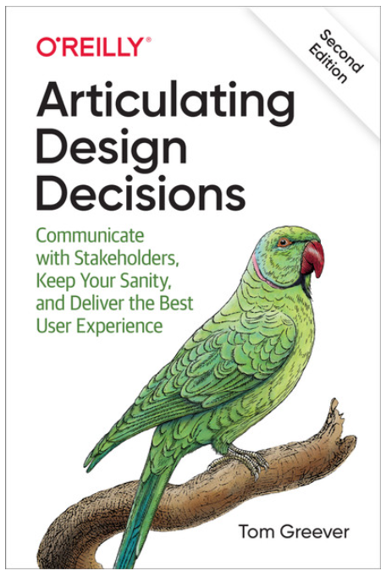
Requirements Gathering (UI/UX)
User Interface and User Experience are essential parts of the requirements gathering process.
Read textbooks about UI/UX.
Articulating Design Decisions, 2nd Edition
Outlined the use of user stories and use cases, appropriate ways to find user interface/ experience.
Focused on three essential things and app needs to be successful.
Notes:
Talk about user interface and user experience in the textbook

Slide 5
Requirements Gathering (UI/UX)
Three things every design needs to be successful:
It solves a problem
Creating goals, externalizing thoughts and ideas.
It’s easy for users
User stories and use cases.
It’s supported by everyone
Support means you can move forward, agreement is necessary.
Notes:
It solves a problem – This involves setting goals for the project and giving them something to accomplish. Finding the most important factors for the stakeholders. Write your thoughts down and externalize thoughts and ideas.
It’s easy for users – It’s essential to make something that is easy for your intended audience of users to use. With each step taken, it’s good to ask yourself “how does this affect the user”. Creating user stories and use cases are an essential part of this step. Useability should be about common sense and research on the target audience.
It’s supported by everyone – Support is about getting agreement to move forward, and this usually happens with stakeholders and your team. This goes with asking and agreeing that this way is better than any alternative way it can be done.

Slide 6
Requirements Gathering (Ursula Tierney)
Had to learn more about mental health with hospital patients.
Got into contact with Ursula Tierney and held a meeting with her.
Insight on the application was gained from the meeting:
Nurses don’t have much time to connect with their patients on a mental health level.
Helped produce a list of aspects the app could have.
Suggested the app could make use of an anxiety AI.
Patient advocates and case managers.
Simple descriptions and 5th/6th grade jargon.
Notes:
Ursula is the mental health nursing instructor here at Xavier University.
Patient advocates – These are the people in the hospital who act as the middleman between patients and doctors. If patients have any pressing questions that they forgot or didn’t feel comfortable asking their doctor, they can go to their patient advocate.
Case managers – These are people in the hospital who help patients transition back to the home life after a hospital stay. It is essential for patients to connect with their case managers, so they know and understand what they need to do in the transition. Ursula said that this would help decrease readmission rates for hospitals, which can get high.
Simple jargon could include pictures as well.

Slide 7
Aspects
Created 4 general groups for aspects to fall under:
Group 1: Connections and Support
Connect with case managers, patient advocates, access to various support groups.
Group 2: Relaxation Exercises
Breathing exercises, sleeping exercises, meditation practices, soft music player.
Group 3: Mindfulness Activities
Creative expression activities, mindfulness exercises, VR experiences.
Group 4: Holistic Care
Physical, mental, emotional, and spiritual care.
Access to journaling and notetaking as well.
Notes:
After reading about requirements gathering and UI/UX, along with the meeting with Ursula… 4 general groups were created:
Connections and Support – Connecting with case managers, patient advocates, and other hospital patients. Includes access to various support groups. These support groups would allow users to get into contact with other people who are going through similar situations (illness/ injury and age). Some sort of moderation or verification would have to implemented for this to be possible of course. Another potential feature would be to have a button that connects patients with their case managers as soon as they leave the hospital.
Relaxation Exercises – Includes breathing exercises, sleeping exercises, meditation practices, and a soft music player.
Mindfulness Activities – Includes mindfulness exercises, creative expression activities (art, writing, music creation), coloring exercises, and possibly virtual reality experiences.
Holistic Care – Holistic care is an approach that considers the entire persons health. This includes, physical, mental, emotional, and spiritual care/health. In spiritual, religious texts and prayers could be found here for patients that would need it.
Note taking and journaling would be other features the user could engage with. Note taking could help prepare for a doctors visit and help remember what they said. Journaling can be beneficial for patients as well.

Slide 8
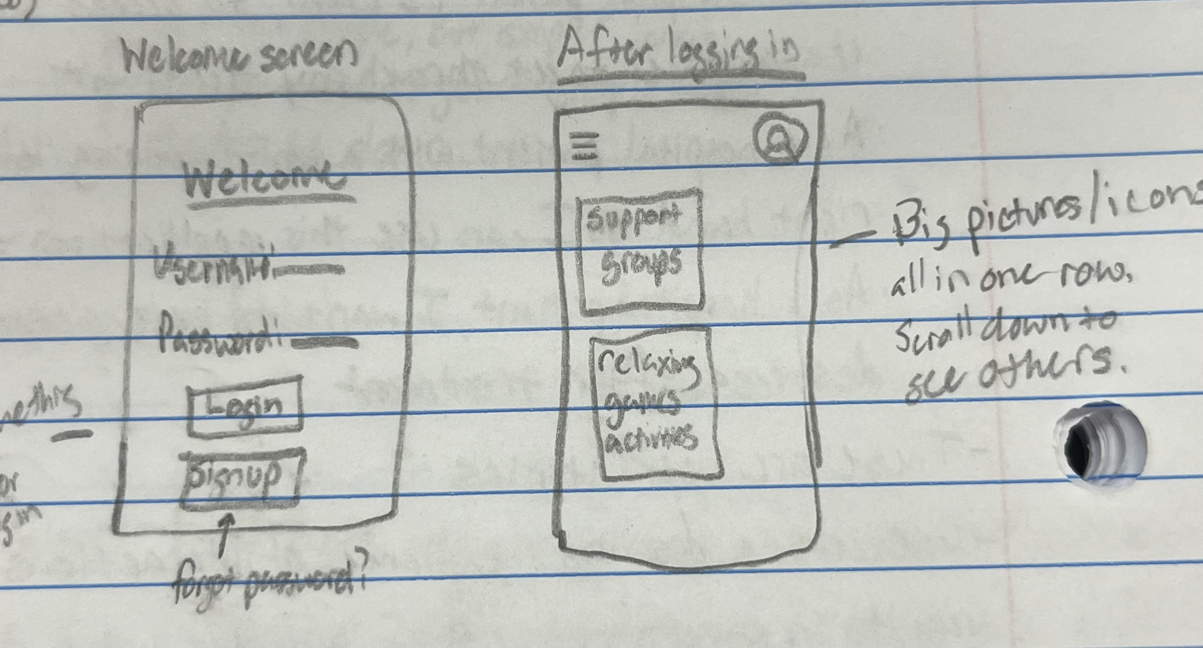
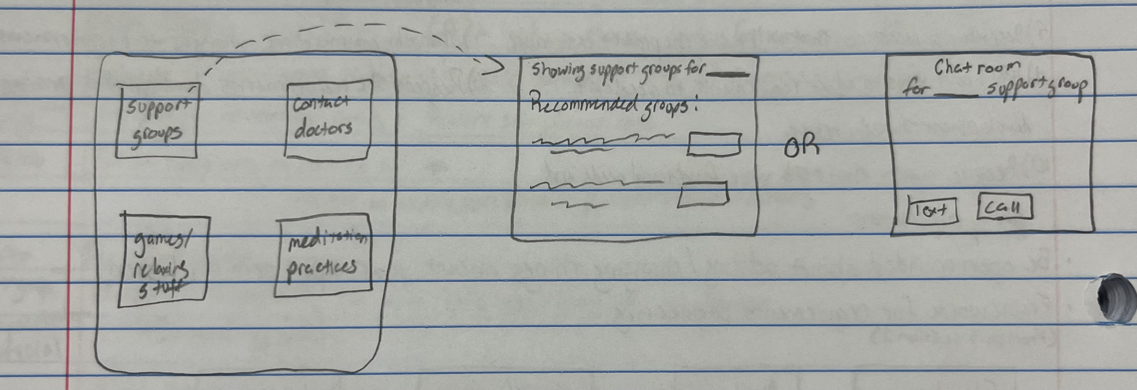
Externalizing Ideas
Wrote ideas out and grouped them in appropriate places.
Sketched out rough ideas of what screens of the app could look like before going into design.
Notes:
Writing ideas out and grouping them in appropriate places helped keep track of ideas for the application and keep the goal for it strong.
Sketching out ideas also helped in imagining what the design would look like.

Slide 9
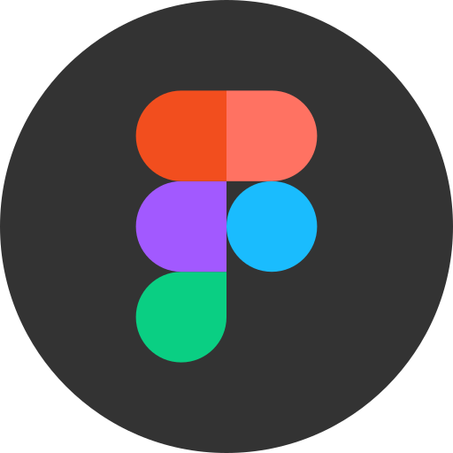
Wireframing and Figma
Wireframing is an essential process in the design stage.
Used Figma to do wireframing.
Figma is a web-based design tool that allows users to create and test designs.
Websites and mobile apps.
Great for wireframing.
Offered for the design on many different devices.
Notes:
Wireframing – This is a process where designers draw overviews of interactive products to establish the structure and flow of possible design solutions.
Talk about how Figma could be broadcasted to your phone to help see the real picture.

Slide 10
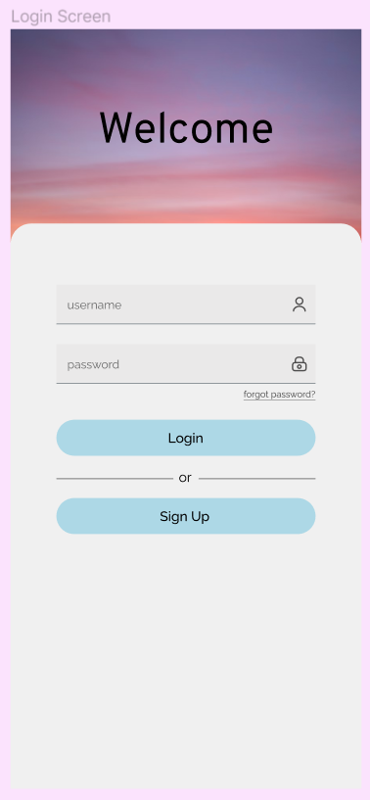
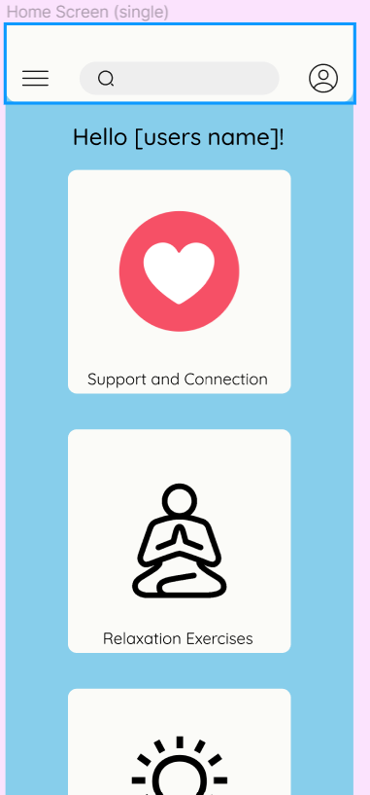
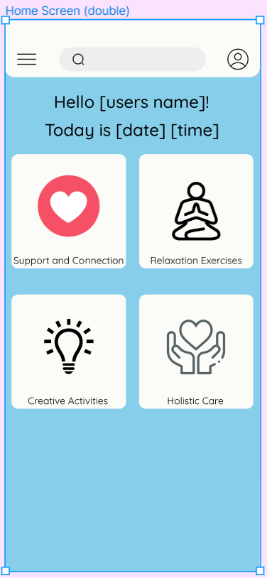
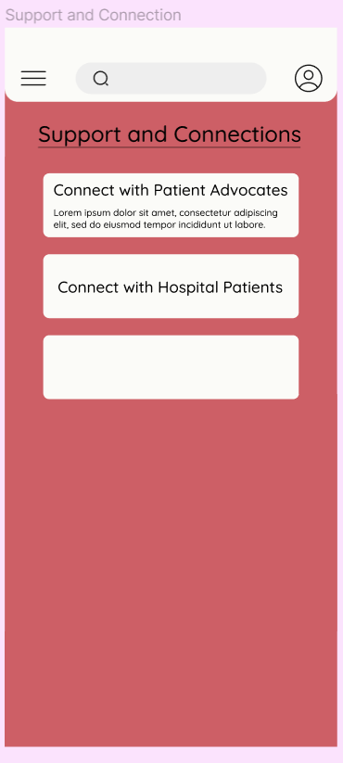
Wireframing and Figma
Login Screen
Home Screen 1
Home Screen 2
Aspect Screen
Notes:
Explain how can’t get the real grasp of the images since their only screenshots, not actually on a phone.

Slide 11
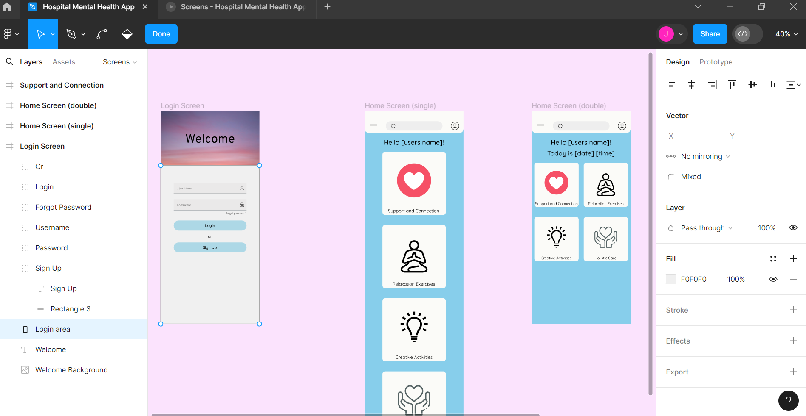
Wireframing and Figma

Slide 12
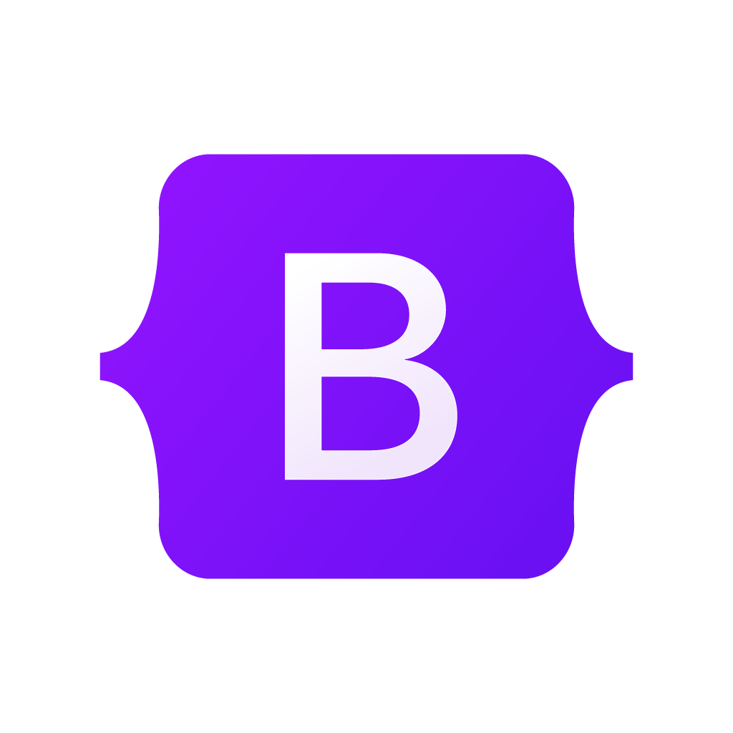
Creating the Website
Used bootstrap in creating the website skeleton.
Navbar
Grid system and containers
With bootstrap, the layout changes in correlation to the user's resolution.
A phone layout appears more condensed than a pc layout.
Notes:
Talk about bootstrap, explain what it is and what I’m using it for. Talk about different website screens I create. Show off the different screens per resolution.

Slide 13
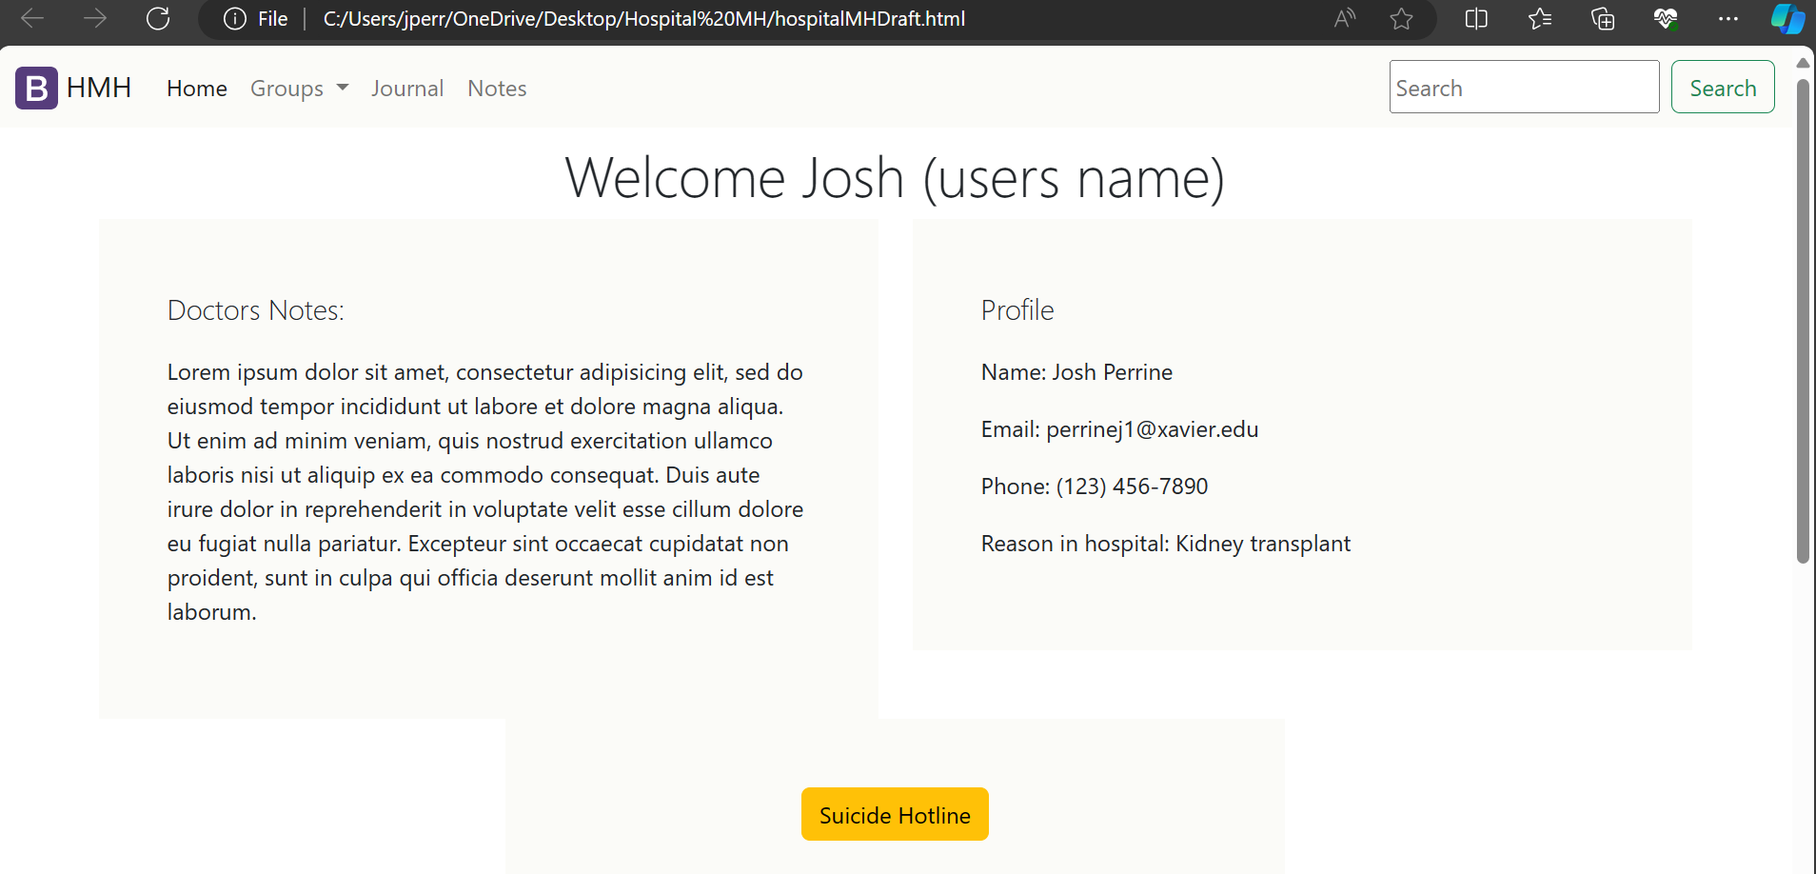
The Website

Slide 14
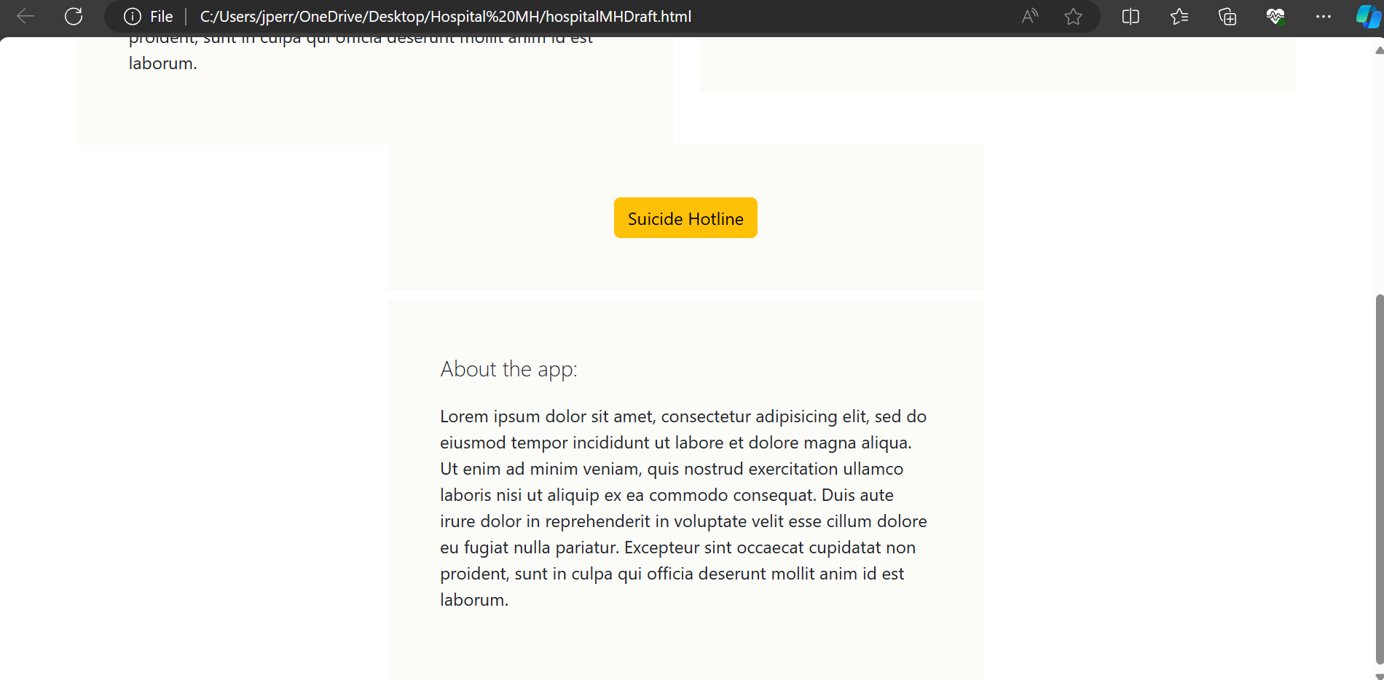
The Website

Slide 15
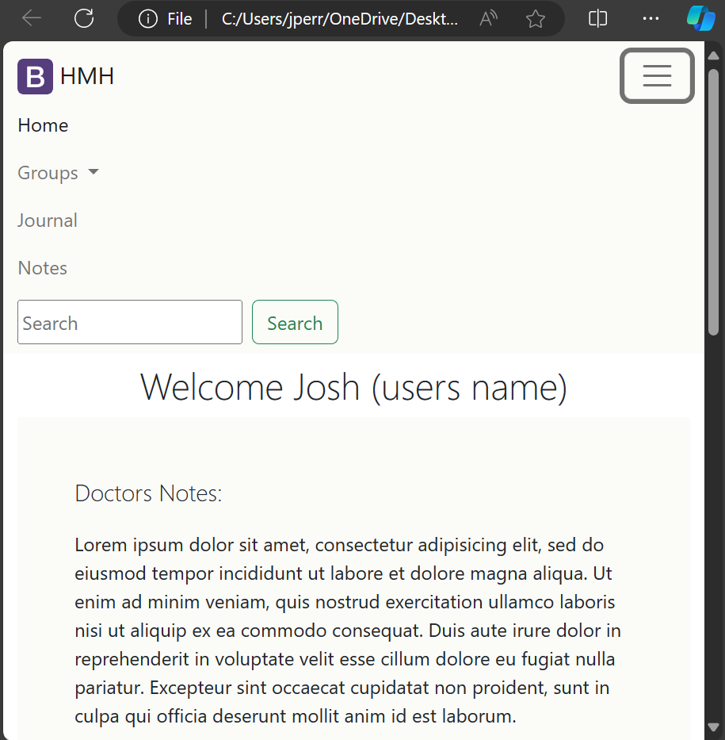
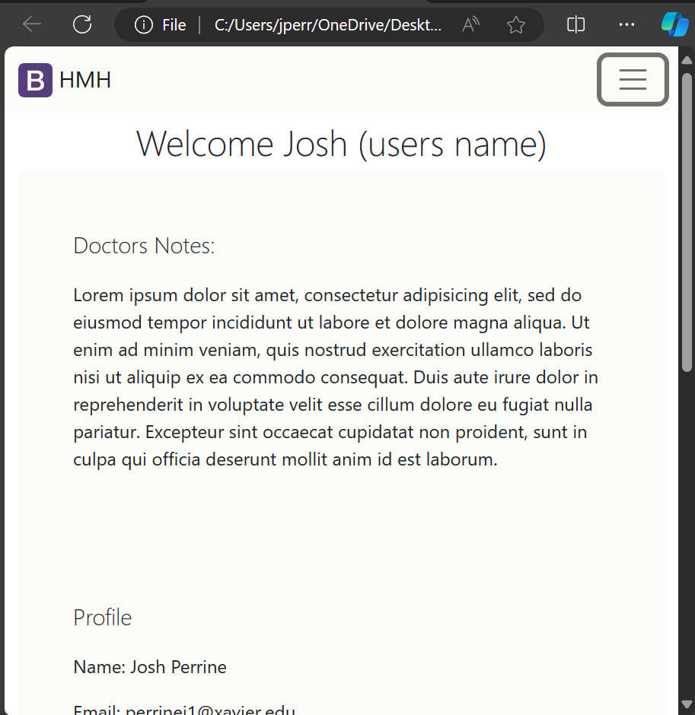
The Website

Slide 16
Project Conclusion
After graduation, I plan on continuing the development of the application.
In a perfect world, I would hope that this app would help hospitals and hospital patients around the globe.
I have learned/ gained:
An understanding in the requirements gathering stage of the software development process.
UI/UX modeling and how it impacts the creation of an application.
An idea of what goes into the first two stages of the software development process.
Figma and Bootstrap.
An understanding that web design could be a potential career path.
Notes:
Talk about the future of the project

Slide 17
Questions?
Notes:
Be prepared for questions about what I plan on doing for other stages of the project or what I think I will do to continue the project.
Answer to this question -

